Slide 1
Drupal Anatomy
Gerald Z. Villorente
open-source developer

Slide 2
About Me
Software Engineer at Kite Systems
FOSS evangelist
and a proud dad

Slide 3
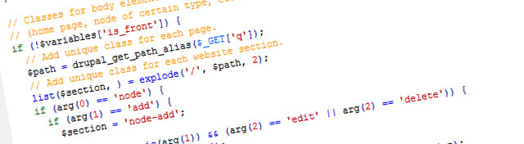
What is Drupal?

Slide 4
Drupal is?
Content Management System
Content Management Framework
Web Application Framework
Written in PHP

Slide 5
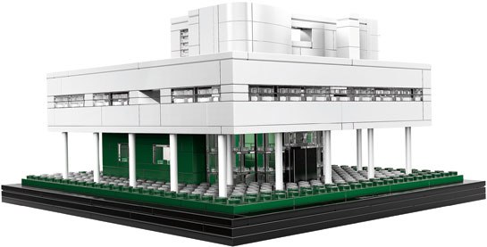
Drupal is like a...
Lego’s model of Le Corbusier’s Villa Savoye. Photo: © 2012, the LEGO Group

Slide 6
Technology Stack

Slide 7
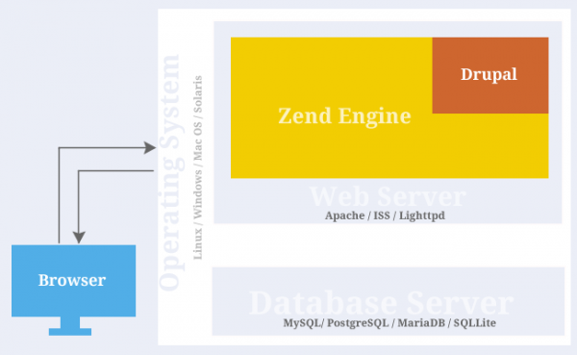
http://techyari.in/understanding-drupal-how-it-actually-works/

Slide 8
Drupal Lingo

Slide 9
Drupal Common Terms
Modules: self-contained applications that provide a specific functionality
  Core
  Contrib
  Custom
Themes: collection of files (PHP, INFO, CSS, JPG, GIF, PNG), which together determine the look and feel of a site
  Core
  Contrib
  Custom
Regions: defined areas of a page where content can be placed

Slide 10
Drupal Common Terms
Blocks: boxes visible in the regions of a Drupal website
Node: a piece of content in Drupal, typically corresponding to a single page on the site
Taxonomy: is the name of a powerful core module that gives your sites use of terms
Vocabulary: collection of terms
Terms: keyword, metadata, or tags
API: application programming interface, a particular set of code and specs that software programs can follow to communicate with each other
Hook: internal Drupal callbacks
Ex: foo_bar() - where “foo” is the name of the module (whose filename is thus foo.module) and “bar” is the name of the hook

Slide 11
The Filesystem

Slide 12
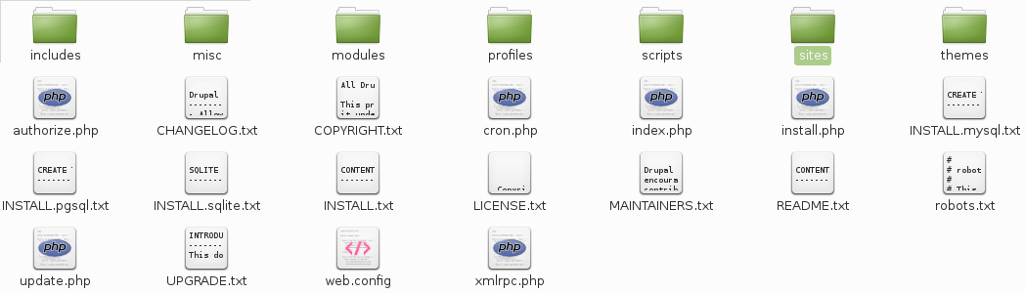
Drupal Root Structure
Golden Rule: Never ever alter/modify the core!

Slide 13
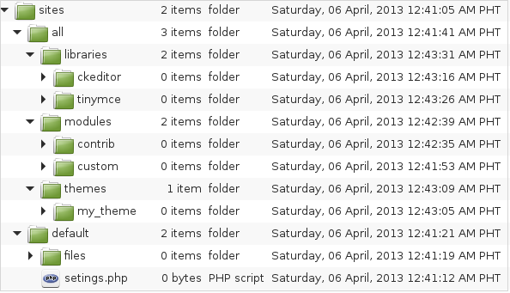
Site Directory Structure
Typical single site setup

Slide 14
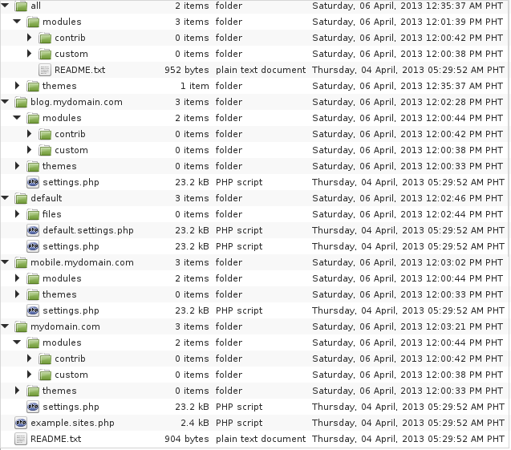
Site Directory Structure
Typical multi site setup

Slide 15
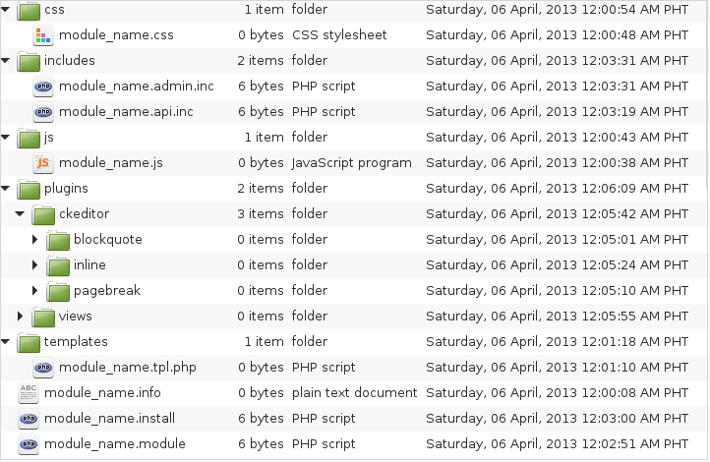
Module Structure

Slide 16
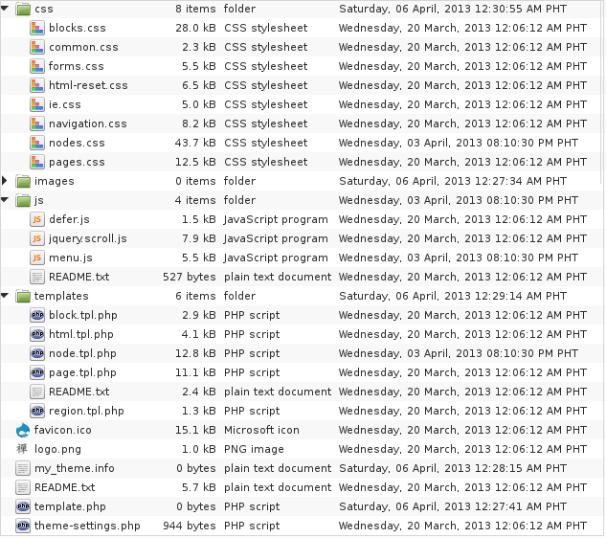
Theme Dir. & Files Structure

Slide 17
Drupal Framework Architecture

Slide 18
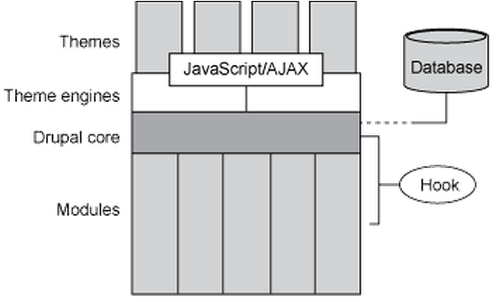
Theme, Module, and Core
http://www.ibm.com/developerworks/library/os-new-drupal-theme/

Slide 19
Theme Layer

Slide 20
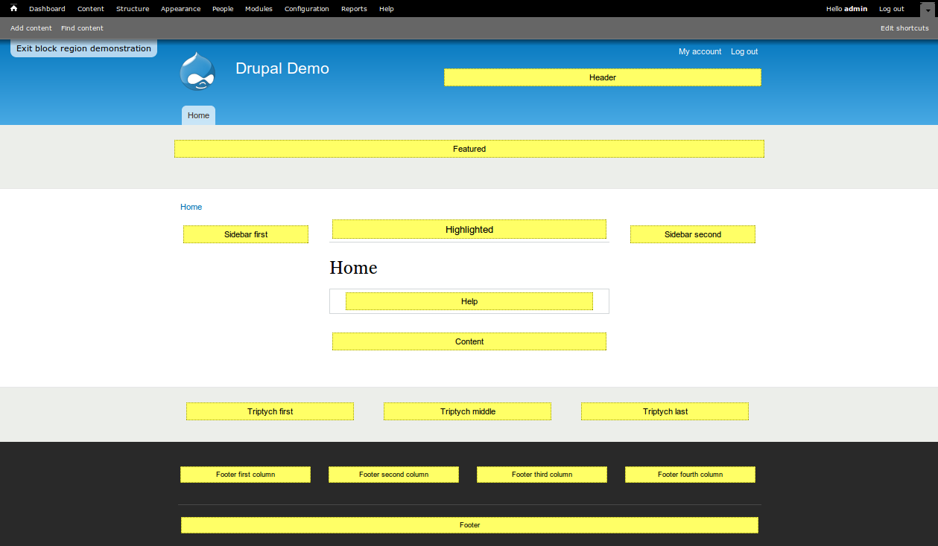
Regions and Blocks

Slide 21
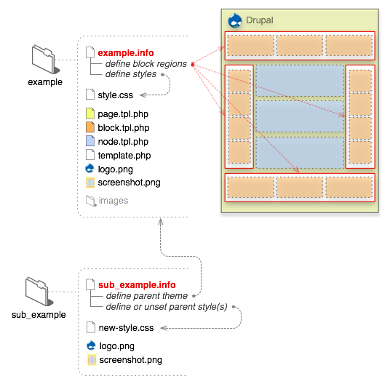
Theme Anatomy
http://drupal.org/node/171194

Slide 22
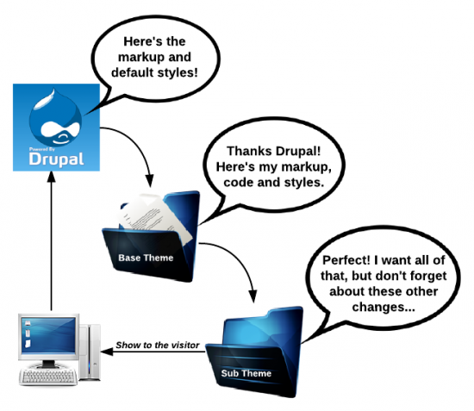
Theme Workflow
http://www.chapterthree.com/blog/david-needham/leveling-your-themer-lvl2-base-themes

Slide 23
Thank You!

Slide 24
Resources
http://drupal.org/documentation
http://api.drupal.org/api/drupal
http://drupal.org/download
http://drupal.org/project/modules
http://drupal.org/forum
http://drupal.stackexchange.com/
http://groups.drupal.org/jobs
http://buildamodule.com/
http://drupalize.me/

